Slide 1

Twitter, Social Media, and Public Outreach
How to be a publicly engaged social scientist

Slide 2
Today:
Part 1: Twitter
Part 2: Journalistic Outreach
Part 3: Op-ed Writing

Slide 3
Warm up activity:
Please write down what you know about twitter:
Positive
Negative

Slide 4
What is Twitter?
Social media
Networking
Self Promotion
Information exchange

Slide 5


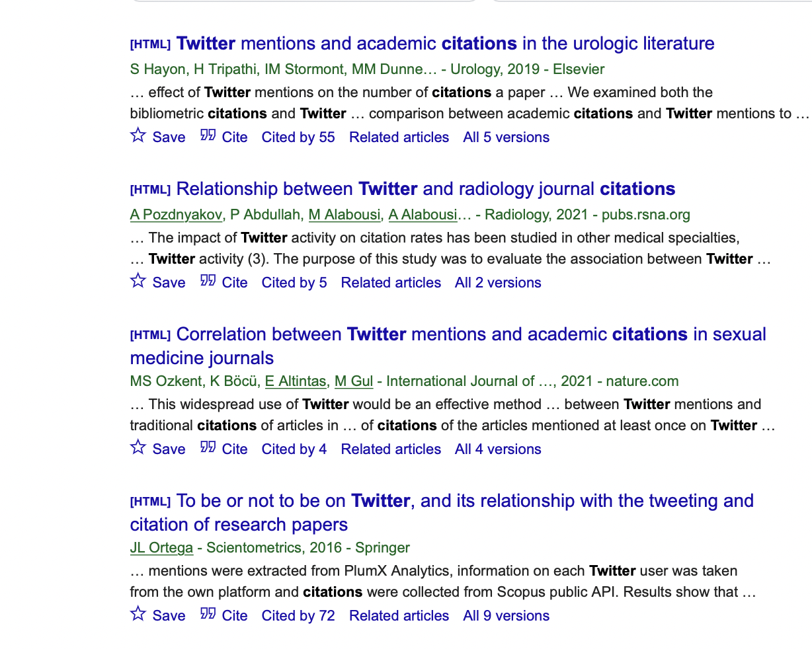
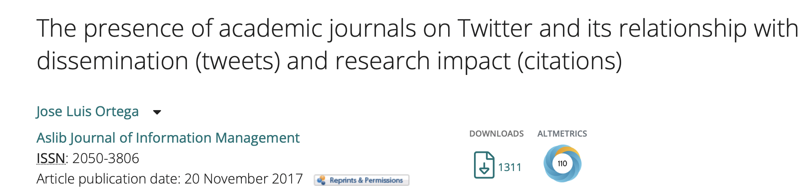
Why should I Tweet?

Slide 6
Laws(?) of Twitter:
Twitter will lead to more professional opportunities and advancement
It varies how much time you must spend on twitter before you see these benefits
Certain people, certain tones, and certain strategies can hasten these advancements

Slide 7
Getting started 1: Profiles
Use a real photo
Bio must be succinct, accurate, and clear.
- Who are you? What do you do? What is your affiliation?
Twitter handle should make sense
- Fine line between personality and professionalism

Slide 8
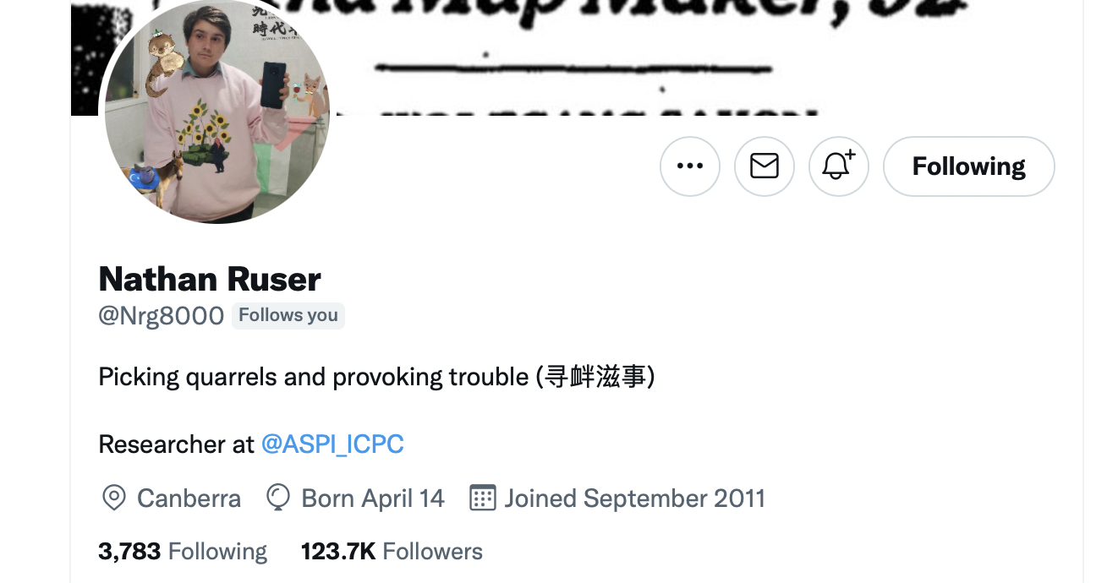
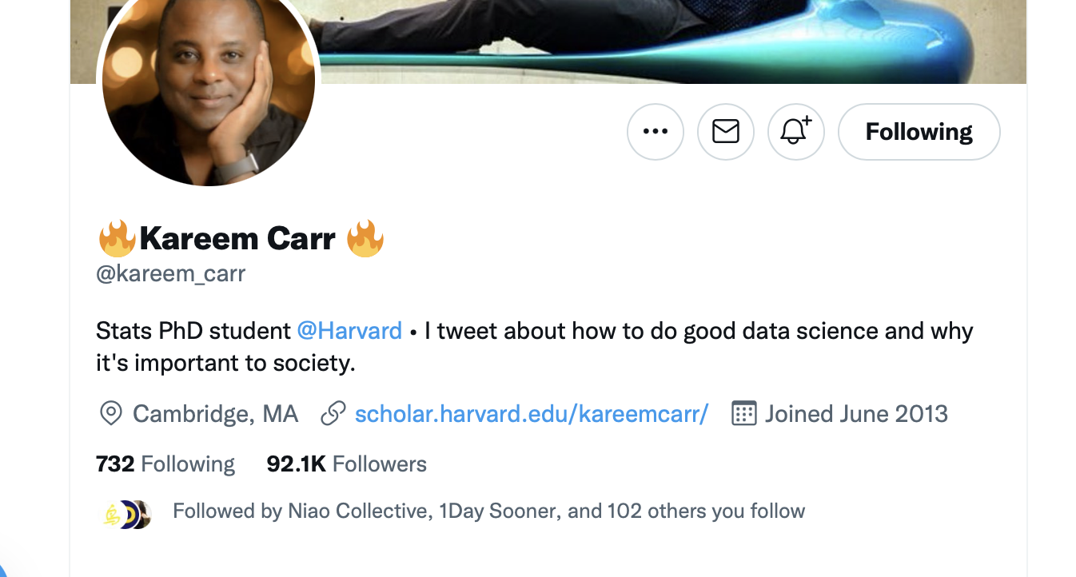
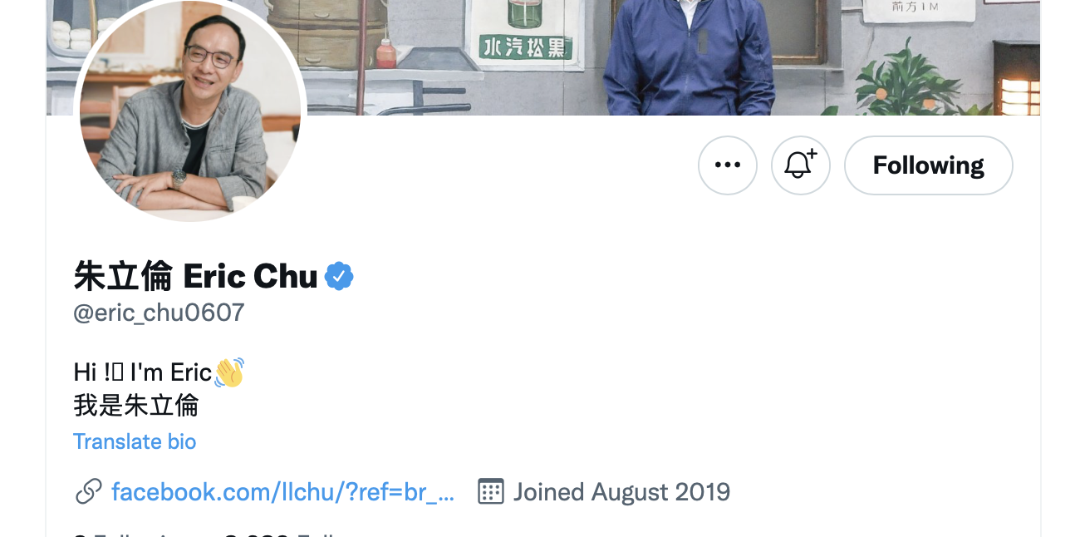
Getting started 1: Profiles
Lets work on our profiles!

Slide 9
Getting started 2: Twitter terminology:
Tweet
Retweet
Quote Tweet
Thread
Follow
Block
Mute
Reply
@
Mentions
#
DM
Communities

Slide 10
Two Modes: Tweeting & Responding

Slide 11
Getting started 2: Types of tweets
Substantive – full sentences, trying to convey something
Casual – conversational, responsive, inviting replies
Shorts – Memes, gifs, one liners, thank yous

Slide 12
Twitter tones:
Professional
Snarky
Funny
Sarcastic
Viral seeking
News sharing

Slide 13
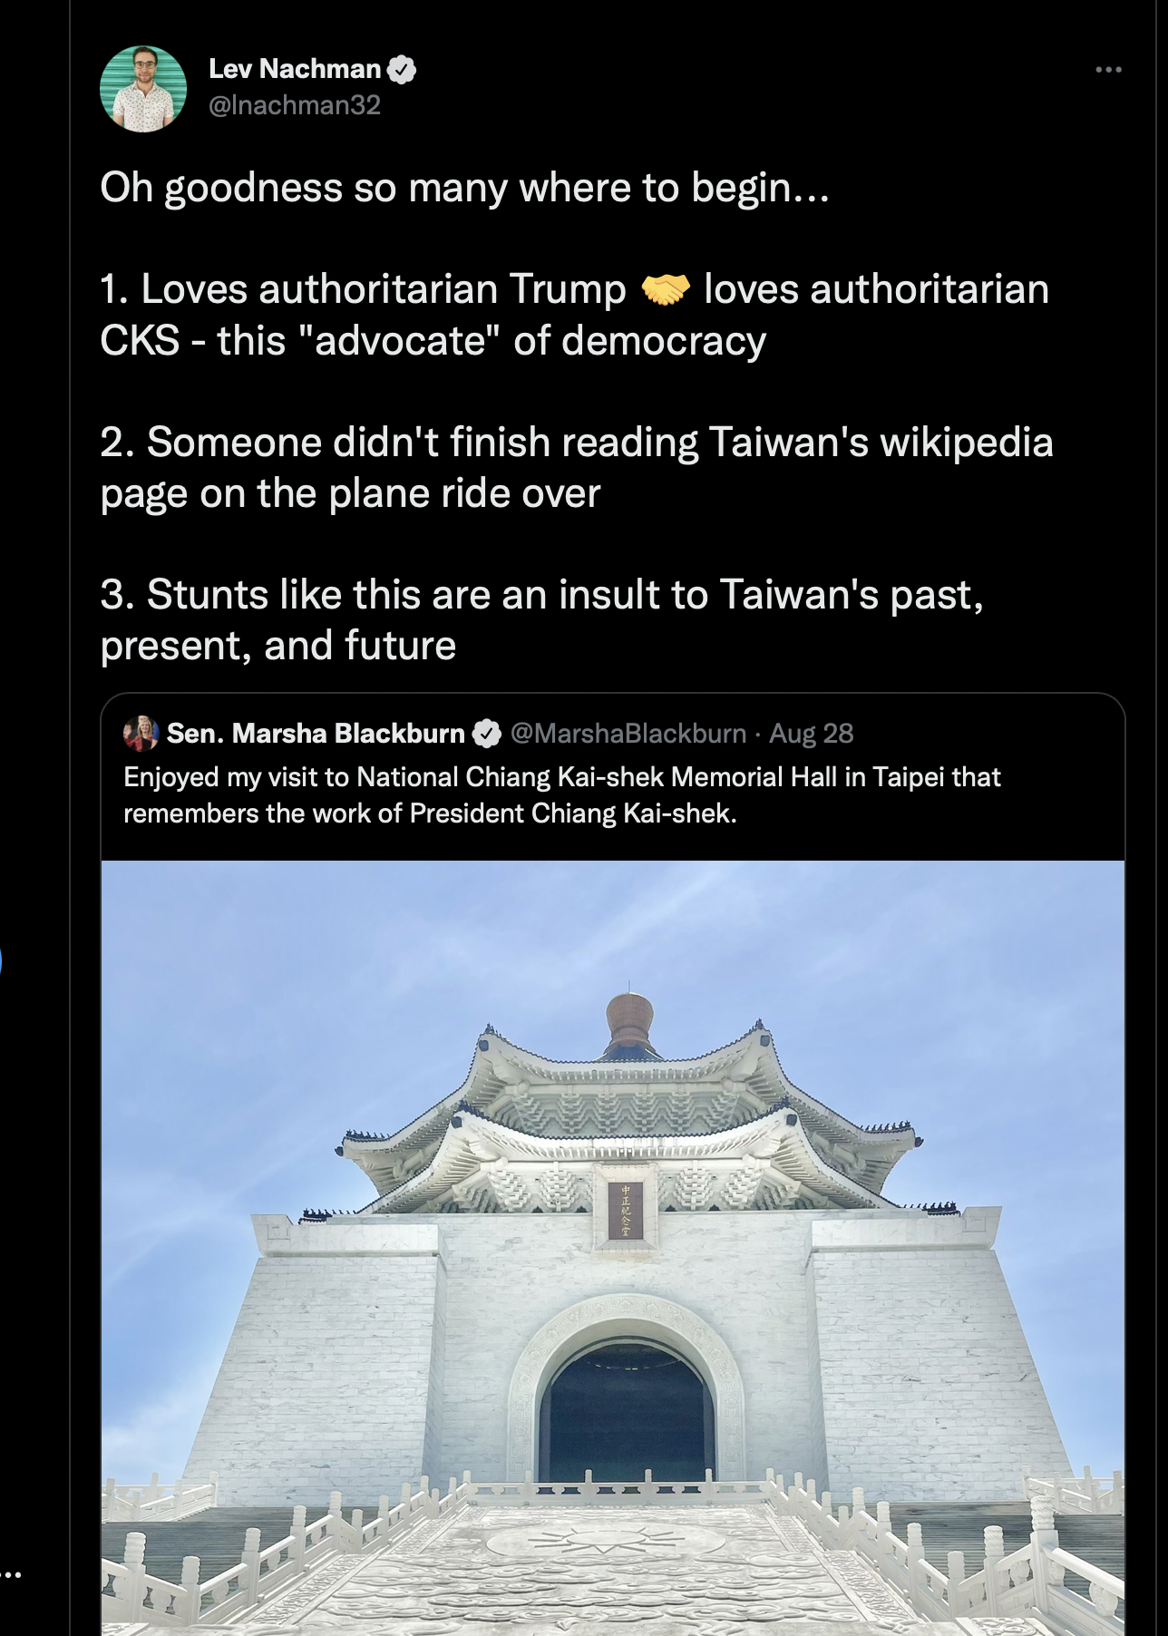
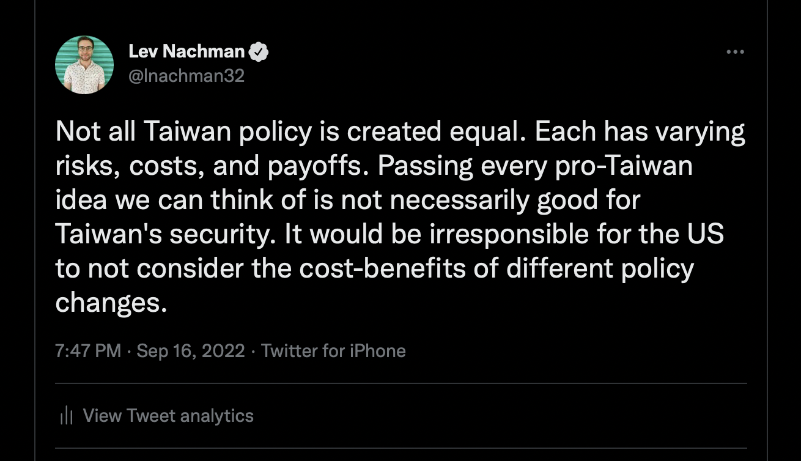
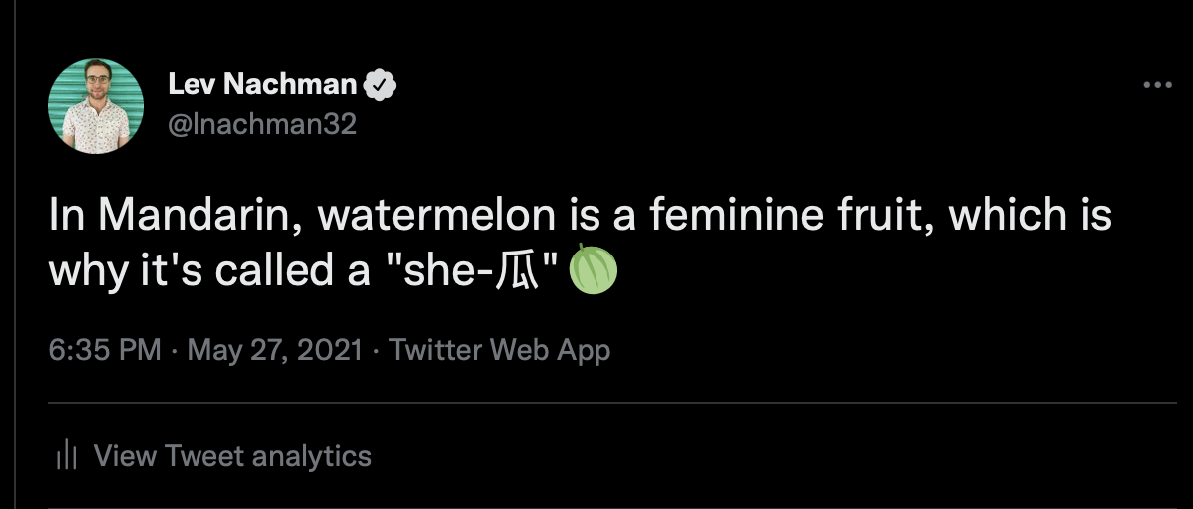
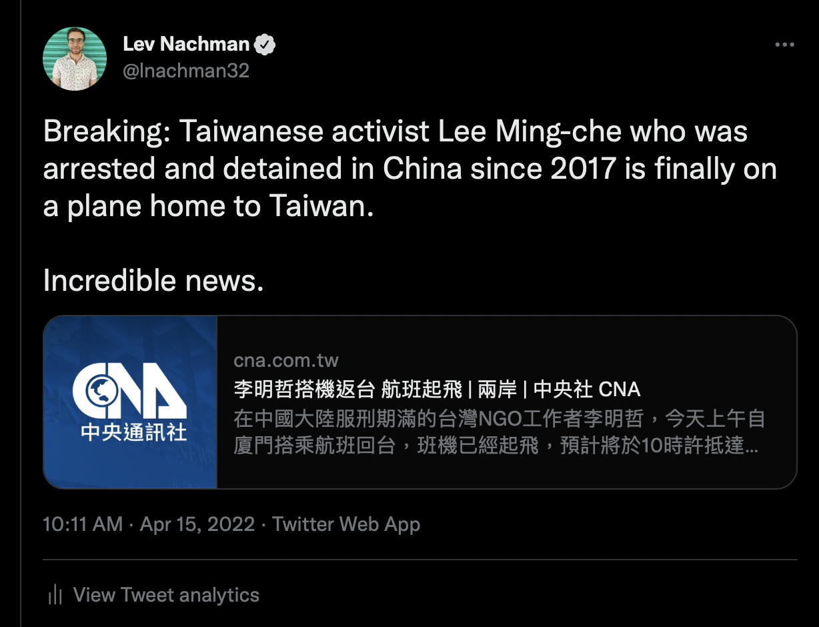
Tone examples:
Snarky
Professional
Funny(?)
News Sharing

Slide 14
How to Tweet:
What is the point I am trying to make?
What are the different ways I can make my point?
What flashy words or hashtags can I use?
Is there anyone I should tag or include in my tweet?
Are there any images, graphs or data I can include?
How many tweets do I need to make my point?

Slide 15
How to Tweet:
The first tweet in a thread is the most important
Practice writing out your tweet in different ways
PROOFREAD
Keep threads to 10 tweets
Images get more traction
Strong language > weak, passive language
Avoid jargon
Would your parents understand the tweet?

Slide 16
How to respond:
Responding versus quote tweeting
Be wary of tone
”reply guys”
Remember all responses are public
Responding to make friends, connections, or get noticed
Striking a balance between responding and offering your own tweets

Slide 17
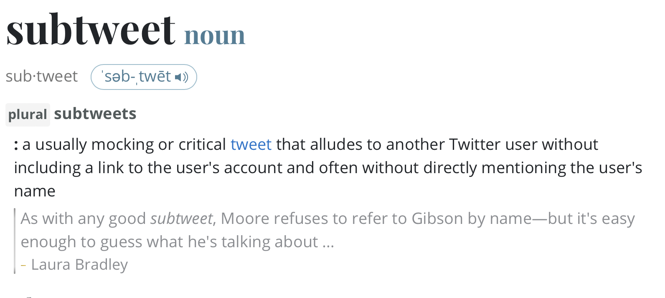
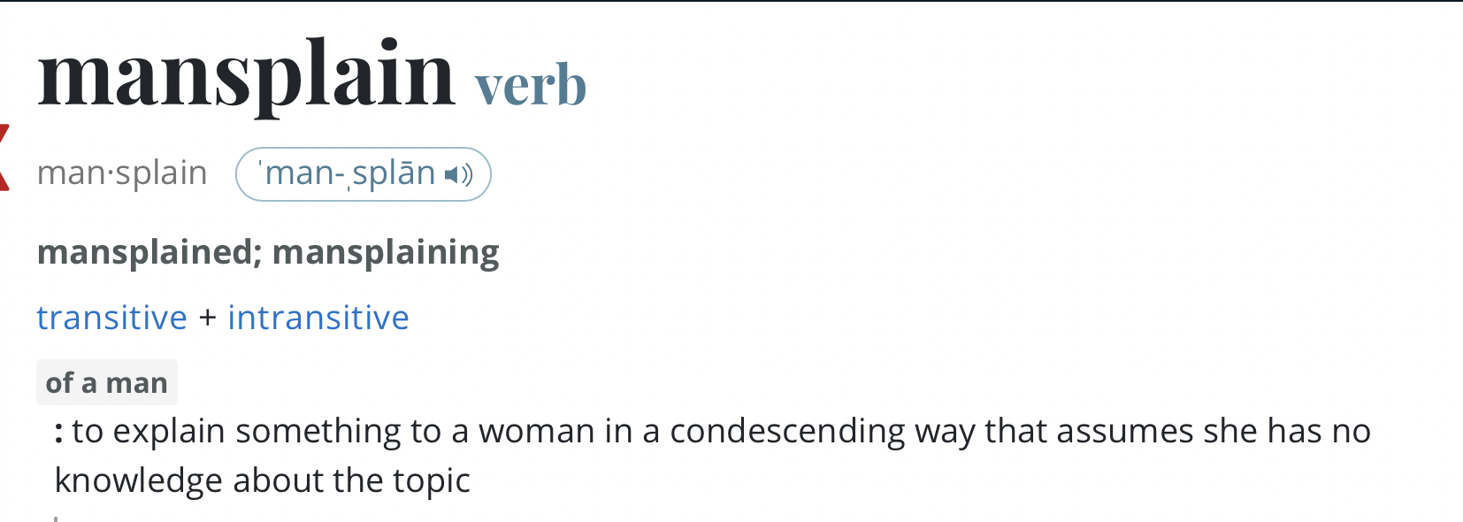
Misc.
Subtweeting
Mansplaining

Slide 18
Finding your audience:
Professional versus personal
Academic twitter
- Social science twitter
- Political science twitter
- Quantitative political science twitter
- quantitative international relations twitter
- quantitative East Asian international relations twitter

Slide 19
English Language Taiwan Twitter
Journalists
Academics
Bloggers
Expats who live in Taiwan
Taiwanese Americans / Diaspora
Policy workers in Washington, DC

Slide 20
Mandarin Language Taiwan Twitter
Skews pan-green
Far fewer users than on other social media
Often talks past / does not interact with English language Taiwan twitter
Some circles are strongly nationalistic

Slide 21
Getting started and Growing your Audience:
Frequency
Try different styles
Meaningful engagement
Respond

Slide 22
Lets practice!
Type out a four-tweet thread explaining your topic, something interesting, and why an average reader should care

Slide 23
Some additional things to keep in mind:
Tweets will last forever (unless you delete them)
Tweets you like are public
People you follow are public
Twitter is stressful and hard, but has high reward
You craft who you are online – be careful, have fun

Slide 24
Part 2: Journalistic Outreach

Slide 25
How to Get Contacted on Twitter
BE AVAILABLE, RESPOND QUICKLY
Reaching out to journalists versus waiting to be reached out to
Strategic tagging
The better your threads, the more journalists will notice
Tweet professionally, not personally
Keep expectations low

Slide 26
How to give an interview:
Don’t use jargon
Speak like you are speaking to your parent
Practice speaking out loud about your topic
Understand the difference between a leading question and an analytical question
Do not let journalists put words into your mouth
Be careful with what you say – if you are on the record, anything you say can be quoted
You might not be quoted

Slide 27
Interview practice!
With a partner, ask them to explain their research in five minutes
Public speaking is hard. Not an instruction, just a fact.

Slide 28
Part 3: Op-eds

Slide 29
What is an Op-Ed
Short (700-1000) word articles
NOT a blog, NOT news
Making an argument as an expert on 1 or 2 issues

Slide 30
Why write op-eds?
Provide context missing from news
Correct context or information in news
Make a point that you feel is missing from political discourse
“own” new research
Share your research with a public audience

Slide 31
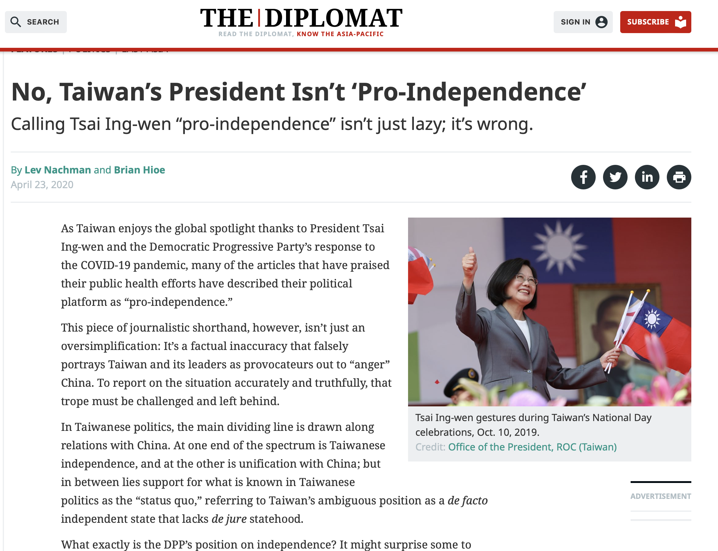
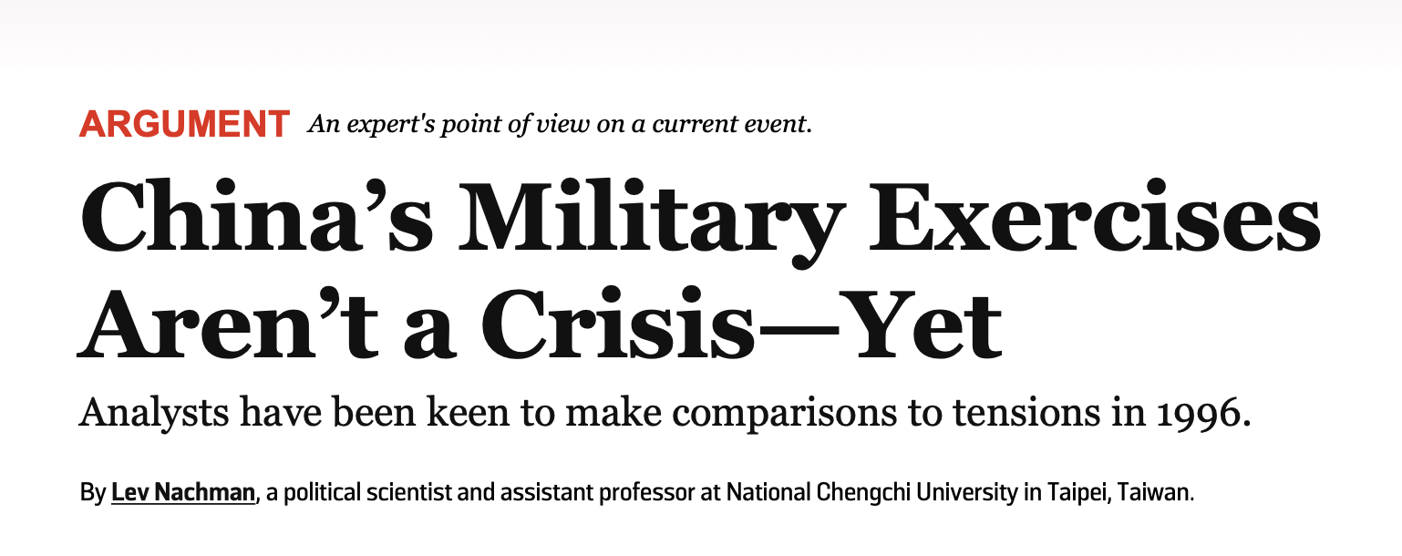
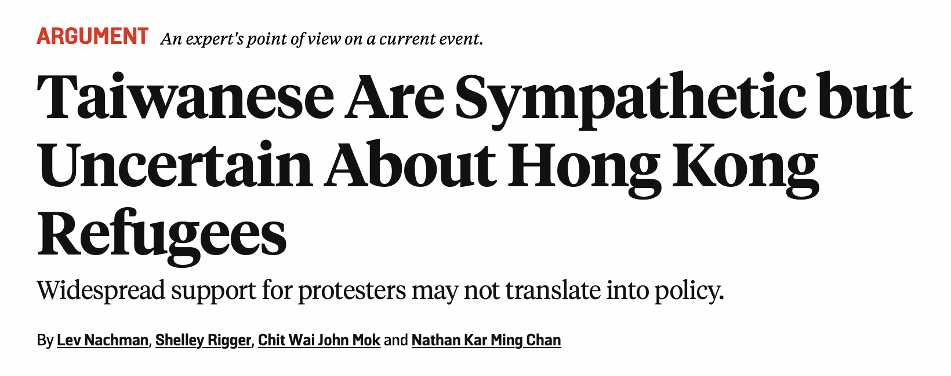
Examples:

Slide 32
How to begin
Write down your argument / thesis statement
It needs to be a clear, strong argument
(remember, you think its an important enough point to write a whole piece about it!)
Outline with topic sentences
Consider your language and audience

Slide 33
Thinking about arguments
What makes a good argument from a bad one?
What kind of data / evidence fits in an op-ed?
Op-eds are read by everyone – language and logic need to follow accordingly

Slide 34
Structuring an op-ed
Part 1: Intro, thesis statement / argument, why it matters, who should care
Part 2: Body: your supporting points that show why your argument is correct
Part 3: Implications: So what? What does your argument change about political discourse
Part 4: Conclusion: What should readers and analysts keep in mind going forward?

Slide 35
What makes a good Op-Ed?
Relevant themes and topics – avoid pedantic points, small arguments, or irrelevant themes
Is your language clear?
Does your voice and narrative overpower the argument you are making?

Slide 36
How to pitch an editor:
Step 1: professional address:
Dear ____
Step 2: self introduction:
I am xyz a student/ scholar / analyst for abc
Step 3: Say this is a pitch
I am writing you to pitch an op-ed I wrote on xyz
Step 4: State the argument in one-two sentences
I argue that abc and show xyz
Step 5: Say why their readers will care about this
My piece would be of interest to xyz readers because abc

Slide 37
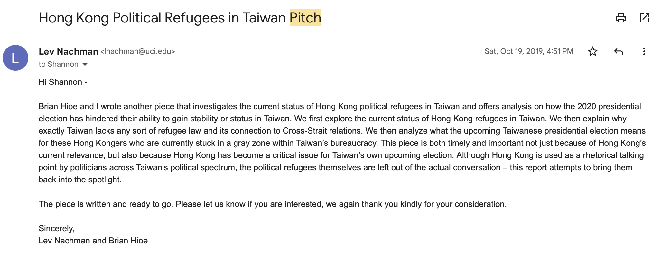
Example:

Slide 38
Pitch practice!

Slide 39
Some Op-Ed points to keep in mind:
Know who you would like to pitch before you start writing
Expect rejection, keep trying
Be your own editor with Op-Eds
Know the insider baseball of who you pitch

Slide 40
Combining Op-Eds and Twitter
How to decide whether to write an op-ed or twitter thread?
Tweet your work, do not be afraid to humble brag!
ALWAYS thank editors, journalists, collaborators
Practice will make you better

Slide 41
Improving my twitter and op-ed writing skills
Take an argument you have with your research:
Write the 1 tweet version of it
Write the 4 tweet version of it
Write the 10 tweet version of it
Write the op-ed version of it

